Slide 1
Chapter 7: Statistical Inference
Business Analytics: Methods, Models,
and Decisions, 1st edition
James R. Evans

Slide 2


Slide 3
Chapter 7 Topics
Hypothesis Testing
One-Sample Hypothesis Tests
Two-Sample Hypothesis Tests
Analysis of Variance
Chi-Square Test for Independence

Slide 4
Hypothesis Testing
Involves drawing inferences about two contrasting propositions (each called a hypothesis) relating to the value of one or more population parameters.
H₀ Null hypothesis: describes an existing theory
H₁ Alternative hypothesis: the complement of H₀
Using sample data, we either:
- reject H₀ and conclude the sample data provides
sufficient evidence to support H_{1,} or
- fail to reject H₀ and conclude the sample data
does not support H_{1.}

Slide 5
Hypothesis Testing
Example 7.1
A Legal Analogy for Hypothesis Testing
In the U.S. legal system, a defendant is innocent until proven guilty.
H₀: Innocent
H₁: Guilty
If evidence (sample data) strongly indicates the defendant is guilty, then we reject H_{0.}
Note that we have not proven guilt or innocence!

Slide 6
Hypothesis Testing
Steps of hypothesis testing procedures
Identify the population parameter and formulate the hypotheses to test.
Select a level of significance (related to the risk of drawing an incorrect conclusion).
Determine the decision rule on which to base a conclusion.
Collect data and calculate a test statistic.
Apply the decision rule and draw a conclusion.

Slide 7
One-Sample Hypothesis Tests
Three forms:
1. H₀: parameter = constant
H₁: parameter ≠ constant
2. H₀: parameter ≤ constant
H₁: parameter > constant
3. H₀: parameter ≥ constant
H₁: parameter < constant
The equality part of the hypotheses sign is always in the Null hypothesis.

Slide 8
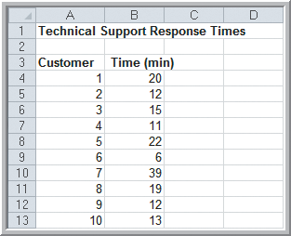
One-Sample Hypothesis Tests
Example 7.2
Formulating a One-Sample Test of Hypothesis
CadSoft believes the average response time for technical support requests can be reduced to less than 25 minutes.
Set up the hypotheses.
H₀: mean response time ≥ 25
H₁: mean response time < 25
Figure 7.1

Slide 9
One-Sample Hypothesis Tests
Understanding Risk in Hypothesis Testing
We always risk drawing an incorrect conclusion.
Four outcomes are possible:
1. H₀ is true and the test correctly fails to reject H₀
2. H₀ is false and the test correctly rejects H₀
3. H₀ is true and the test incorrectly rejects H₀
4. H₀ is false and the test incorrectly fails to reject H₀
Outcome 3 is called a Type I error.
Outcome 4 is called a Type II error.

Slide 10
One-Sample Hypothesis Tests
Understanding Risk in Hypothesis Testing
The probability of making a Type I error = α
The probability of making a Type II error = β
α = P( rejecting H₀ | H₀ is true)
β = P(not rejecting H₀ | H₀ is false)
The value of α can be controlled.
α is typically set to 0.01, 0.05, or 0.10.
The value of β cannot be specified in advance and depends on the value of the (unknown) population parameter.

Slide 11
One-Sample Hypothesis Tests
Example 7.3
How β Depends on the True Population Mean
In the CadSoft example:
H₀: mean response time ≥ 25
H₁: mean response time < 25
If the true mean was 15, then the sample mean will most likely be less than 25.
If the true mean is 24, then the sample mean may or may not be less than 25.
The further away the true mean is from the hypothesized value, the smaller the value of β.

Slide 12



One-Sample Hypothesis Tests
Computing the test statistic
One-sample test on a mean, σ known
One-sample test on a mean, σ unknown
One-sample test on a proportion

Slide 13
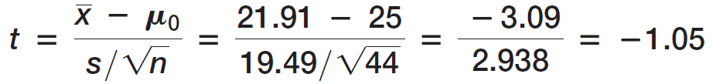
One-Sample Hypothesis Tests
Example 7.4 Computing the Test Statistic
In the CadSoft example, sample data for 44 customers revealed a mean response time of 21.91 minutes and a sample standard deviation of 19.49 minutes.
t = -1.05 indicates that the sample mean of 21.91 is 1.05 standard errors below the hypothesized mean of 25 minutes.

Slide 14
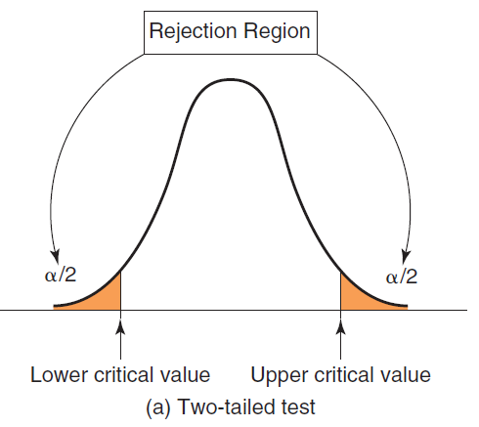
One-Sample Hypothesis Tests
Drawing Conclusions in a Two-tailed Test
H₀: parameter = constant
H₁: parameter ≠ constant
Figure 7.2a

Slide 15
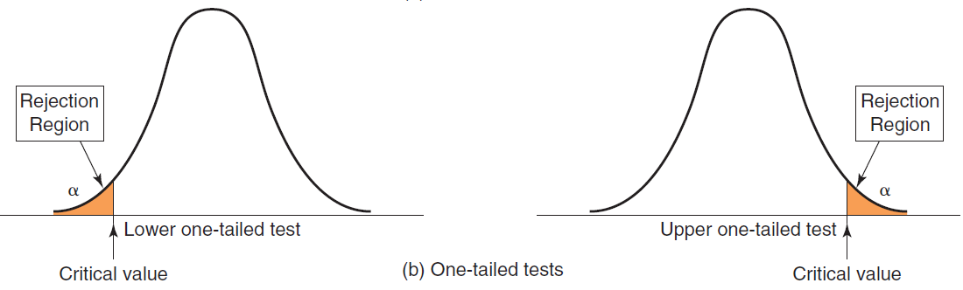
One-Sample Hypothesis Tests
Drawing Conclusions in One-tailed tests
H₀: parameter ≥ constant
H₁: parameter < constant
H₀: parameter ≤ constant
H₁: parameter > constant
Figure 7.2b

Slide 16
One-Sample Hypothesis Tests
Example 7.5
Finding the Critical Value and Drawing a Conclusion
In the CadSoft example, suppose we set α = 0.05.
n = 44
df = n −1 = 43
t = -1.05
Critical value = t_{α/2, n−1} = T.INV(1− α , n −1)
= T.INV(0.95, 43)
= 1.68
H₀: mean response time ≥ 25
H₁: mean response time < 25

Slide 17
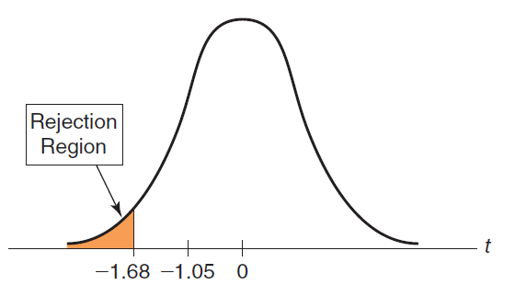
One-Sample Hypothesis Tests
Example 7.5 (continued)
Finding the Critical Value and Drawing a Conclusion
t = -1.05 does not fall in the rejection region.
Fail to reject H_{0.}
Even though the sample mean of 21.91 is well below 25, we have too much sampling error to conclude the that the true population mean is less than 25 minutes.
Figure 7.3

Slide 18
One-Sample Hypothesis Tests
p-Values
An alternative approach to Step 3 of any hypothesis test (setting up a decision rule) uses the p-value rather than the critical value.
The p-value is the observed significance level.
The p-value decision rule is to:
Reject H₀ if the p-value < α

Slide 19
One-Sample Hypothesis Tests
Example 7.6 Using p-Values
In the CadSoft example, the p-value is the left tail area of the observed test statistic, t = -1.05.
p-value =T.DIST(test statistic, df, true)
=TDIST(-1.05, 43, true)
= 0.1498
Do not reject H₀ because the:
p-value is not less than α
0.1498 is not less than 0.05

Slide 20
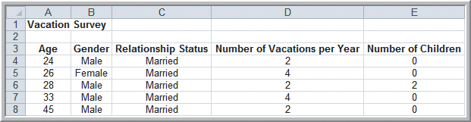
One-Sample Hypothesis Tests
Example 7.7 Conducting a Two-Tailed Hypothesis Test for the Mean
Use the data set Vacation Survey to test whether the average age of respondents is equal to 35.
Test at a 5% significance level.
For the 34 respondents we find a sample mean of 38.677 and sample standard deviation of 7.858.
Figure 7.4

Slide 21
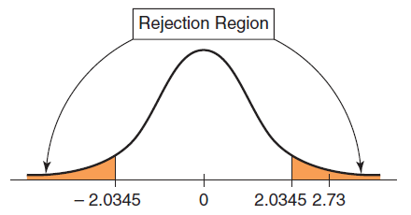

One-Sample Hypothesis Tests
Example 7.7 (continued) Conducting a Two-Tailed Hypothesis Test for the Mean
Critical value = T.INV.2T(α, df)
= T.INV.2T(.05, 33) = 2.0345
p-value = T.DIST.2T(2.73, 33) = 0.0111
Reject H₀.
H₀: mean age = 35
H₁: mean age ≠ 35
Figure 7.5

Slide 22
One-Sample Hypothesis Tests
Example 7.8 One-Sample Test for the Proportion
CadSoft sampled 44 customers and asked them to rate the overall quality of a software package.
Sample data revealed that 35 respondents thought the software was very good or excellent.
In the past, 75% of customers fell into that category.
At the 5% significance level, test to see whether the percentage of customers in that category is now higher than 75%.

Slide 23

One-Sample Hypothesis Tests
Example 7.8 (continued)
One-Sample Test for the Proportion
Critical value = NORM.S.INV(0.95) = 1.645
p-value = 1 − NORM.S.DIST(0.69, true) = 0.24
Do not reject H_{0.}
H₀: proportion < 0.75
H₁: proportion ≥ 0.75

Slide 24
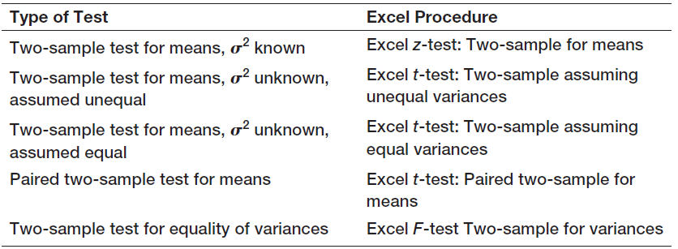
Two-Sample Hypothesis Tests
Two-Sample Hypothesis Tests Available
in Excel’s Analysis Toolpak
Table 7.1

Slide 25
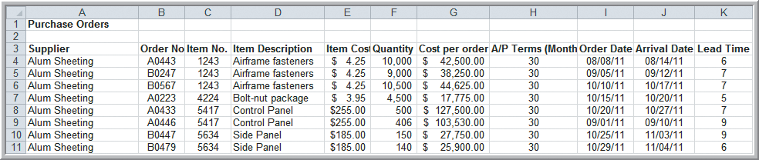
Two-Sample Hypothesis Tests
Example 7.9 Comparing Supplier Performance
Purchase Orders database
Set up a hypothesis test for determining if the mean lead time for Alum Sheeting (µ₁) is greater than the mean lead time for Durrable Products (µ₂).
Figure 7.6

Slide 26
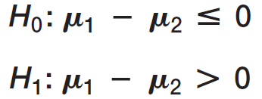
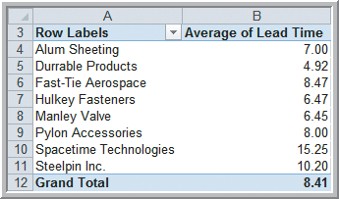
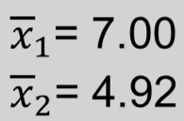
Two-Sample Hypothesis Tests
Example 7.9 (continued)
Comparing Supplier Performance
PivotTable shows:
Figure 7.7

Slide 27
Two-Sample Hypothesis Tests
Excel’s Two-sample Hypothesis Tests on Means
If the population variances are known, use:
z-Test: Two-Sample for Means
If the population variances are unknown then, in most situations, use:
t-Test: Two-Sample Assuming Unequal Variances
If the population variances are unknown but assumed to be equal, then use:
t-Test: Two-Sample Assuming Equal Variances

Slide 28

Two-Sample Hypothesis Tests
Cautions when Interpreting Excel’s Two-sample
Hypothesis Test Output
If the test statistic is negative, Excel’s one-tail p-
value is correct for a lower tail test. For an upper
tail test, subtract the reported p-value from 1
The reverse is true when the test statistic is non-
negative
The critical value reported in Excel should be
multiplied by -1 if
Copyright © 2013 Pearson Education, Inc.
publishing as Prentice Hall
7-28

Slide 29
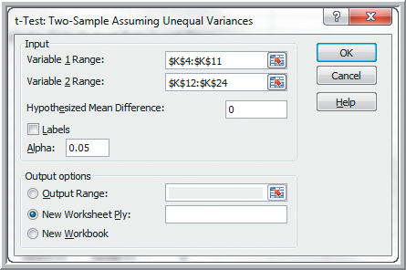
Two-Sample Hypothesis Tests
Example 7.10 Testing the Hypothesis for Supplier
Lead-Time Performance
Data
Data Analysis
t-Test: Two-Sample
Assuming Unequal
Variances
Variable 1 Range: Alum Sheeting data
Variable 2 Range: Durrable Products data
Figure 7.8

Slide 30
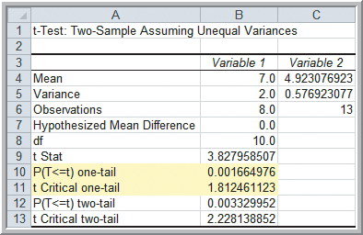
Two-Sample Hypothesis Tests
Example 7.10 (continued) Testing the Hypothesis for Supplier Lead-Time Performance
t = 3.83
Critical value = 1.81
p-value = 0.00166
Reject H₀.
Figure 7.9

Slide 31
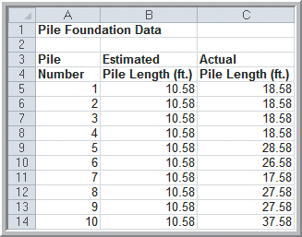
Two-Sample Hypothesis Tests
Example 7.11
Using the Paired Two-Sample Test for Means
Use the Pile Foundation data to test for a difference in the means of the estimated and actual pile lengths.
Use a 5% significance level.
H₀: μ_{D} = 0
H₁: μ_{D} ≠ 0
where μ_{D} is the difference
between the 2 population
means.
Figure 7.10

Slide 32
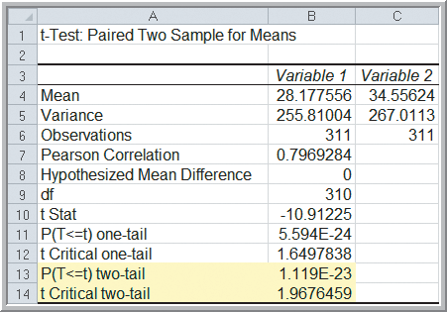
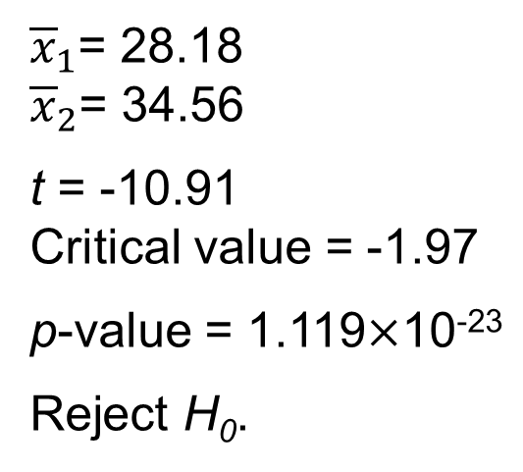
Two-Sample Hypothesis Tests
Example 7.11 (continued)
Using the Paired Two-Sample Test for Means
t-Test: Paired Two-Sample for Means
Figure 7.11

Slide 33
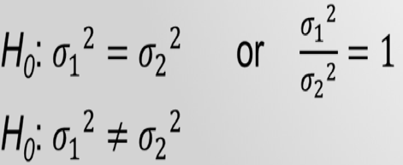
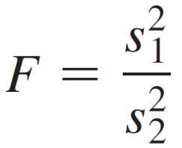
Two-Sample Hypothesis Tests
Test for Equality of Variances
Understanding variation in business processes
is very important.
We can test for equal variability of two groups:
The ratio of two population variances follow an
F probability distribution.
The test statistic is

Slide 34
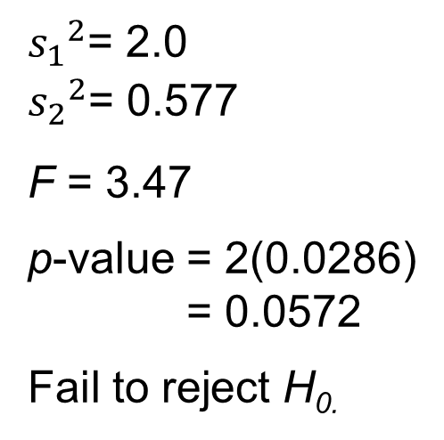
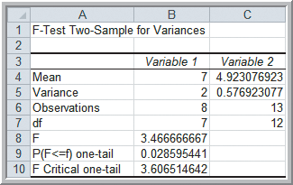
Two-Sample Hypothesis Tests
Example 7.12
Applying the F-Test for Equality of Variances
Using α = 0.05, test for equal variances in the lead times of Alum Sheeting and Durrable Products.
Figure 7.12

Slide 35

Analysis of Variance
ANOVA
Used to compare the means of two or more population groups.
ANOVA derives its name from the fact that we are analyzing variances in the data.
ANOVA measures variation between groups relative to variation within groups.
Each of the population groups is assumed to come from a normally distributed population.

Slide 36
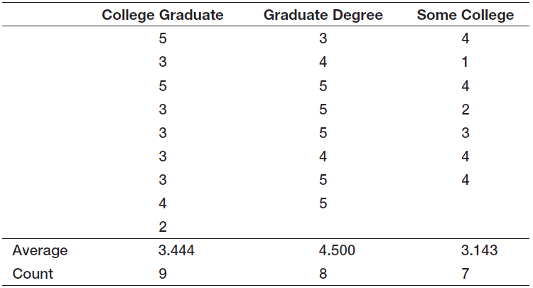
Analysis of Variance
Example 7.13
Differences in Insurance Survey Data
Average health insurance satisfaction scores (1-5 scale) by education level

Slide 37
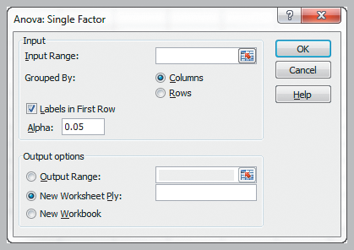
Analysis of Variance
Example 7.14 Applying the Excel ANOVA Tool
(Insurance Survey data)
Data
Data Analysis
ANOVA: Single Factor
Input Range:
contiguous columns
of insurance
satisfaction data
H₀: μ₁ = μ₂ = μ₃
H₁: at least one mean is different from the others
Figure 7.13

Slide 38
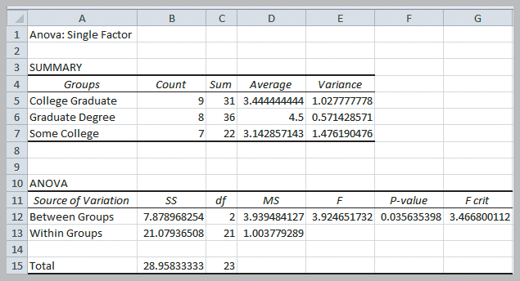
Analysis of Variance
Example 7.14 (continued)
Applying the Excel ANOVA Tool
Use α = 5%.
F > F_{crit}
p-value
= 0.0356
Reject H_{0.}
Figure 7.14

Slide 39


Chi-Square Test for Independence
Test for independence of 2 categorical variables.
Compute expected frequencies and compare to the observed frequencies in the sample data.
H₀: two categorical variables are independent
H₁: two categorical variables are dependent

Slide 40
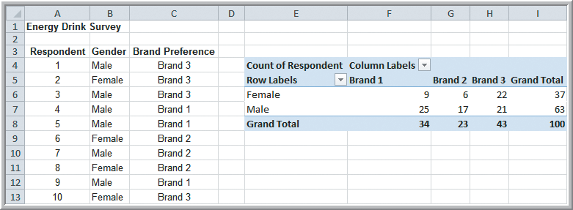
Chi-Square Test for Independence
Example 7.15
Independence and Marketing Strategy
Using a 5% significance level test, determine whether gender and brand preference for energy drinks can be considered independent variables.
Figure 7.15

Slide 41
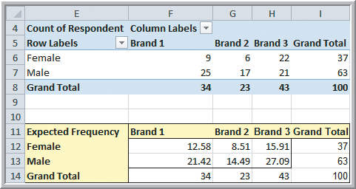
Chi-Square Test for Independence
Example 7.16 Computing Expected Frequencies
Cell F12:
f_{e} = (37)(34)
100
=16* F8/18
Figure 7.16

Slide 42
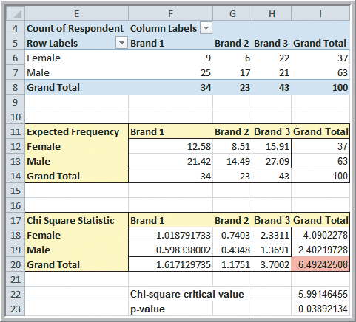
Chi-Square Test for Independence
Example 7.17 Conducting the Chi-Square Test
Cell F18:
(f_{o} - f_{e})²/f_{e} = 1.018
Cell 120:
χ² = 6.49
=SUM(F18:H19)
Figure 7.17

Slide 43
Chi-Square Test for Independence
Example 7.17 (continued)
Conducting the Chi-Square Test (at α = 5%)
Critical Value Approach:
df = (r - 1)(c-1)
= (2 - 1)(3 - 1) = 2
Cell 122:
= CHISQ.INV.RT(α, df)
= CHISQ.INV.RT(0.5, 2)
Critical value = 5.99
χ² = 6.49 > 5.99
Reject H₀.
Figure 7.17

Slide 44
Chi-Square Test for Independence
Example 7.17 (continued)
Conducting the Chi-Square Test (at α = 5%)
p-Value Approach:
Cell 123:
=CHISQ.TEST(f_{o}, f_{e)}
=CHISQ.TEST(F6:H7,
F12:H13)
p-value = 0.0389
Reject H₀.
Figure 7.17

Slide 45

Two-Sample Hypothesis Tests
Analytics in Practice:
Using Hypothesis Tests and Business Analytics in a Help Desk Service Improvement Project
Schlumberger International is an international oilfield-services provider headquartered in Houston, Texas.
Their help desk moved from Ecuador to Houston after two-sample hypothesis tests supported it.
Use of various analytical techniques enabled their help desk service to improve dramatically.

Slide 46
Chapter 7 - Key Terms
Alternative hypothesis
Analysis of variance (ANOVA)
Chi-square distribution
Chi-square statistic
Confidence coefficient
Factor
Hypothesis
Level of significance
Null hypothesis

Slide 47
Chapter 7 - Key Terms (continued)
One-sample hypothesis tests
One-tailed test of hypothesis
p-value (observed significance level)
Power of the test
Statistical inference
Two-tailed tests of hypothesis
Type I error
Type II error

Slide 48

Recall that PLE produces lawnmowers and a medium
size diesel power lawn tractor.
Look into differences in customer satisfaction by region
and type of satisfaction measure.
Determine whether on-time deliveries, defectives, and
process costs have improved.
Investigate employee retention as a function of gender,
college graduation, and home location.
Write a formal report summarizing your results.
Copyright © 2013 Pearson Education, Inc.
publishing as Prentice Hall
7-48

Slide 49


